Slide 1
Economic Impact of Sports Events
Chapter 15

Slide 2
Economic Impact Analysis
How to perform an economic impact study:
Measure all net spending (incremental spending) in the local area that is the result of hosting the event, accounting for displacement & substitution
Displacement – when out-of-town visitors who attend the event cause other potential visitors go elsewhere
Substitution – when local residents buy hot dogs at the ballpark instead of lunch at their usual place
Apply local impact multipliers
Total Economic impact = Multiplier * Net Incremental Spending
Calculate the cost of hosting (overtime pay for the police, emergency personnel, cleanup cost, congestion costs etc)
Find (Spending – Cost of hosting)
Issues:
Impossible to control for displacement and substitution
Hard to find the exact multiplier

Slide 3
Multipliers
The marginal propensity to consume, or MPC, is the increase in consumer spending when disposable income rises by $1.
The marginal propensity to save, or MPS, is the increase in household savings when disposable income rises by $1.
MPC + MPS = 1

Slide 4
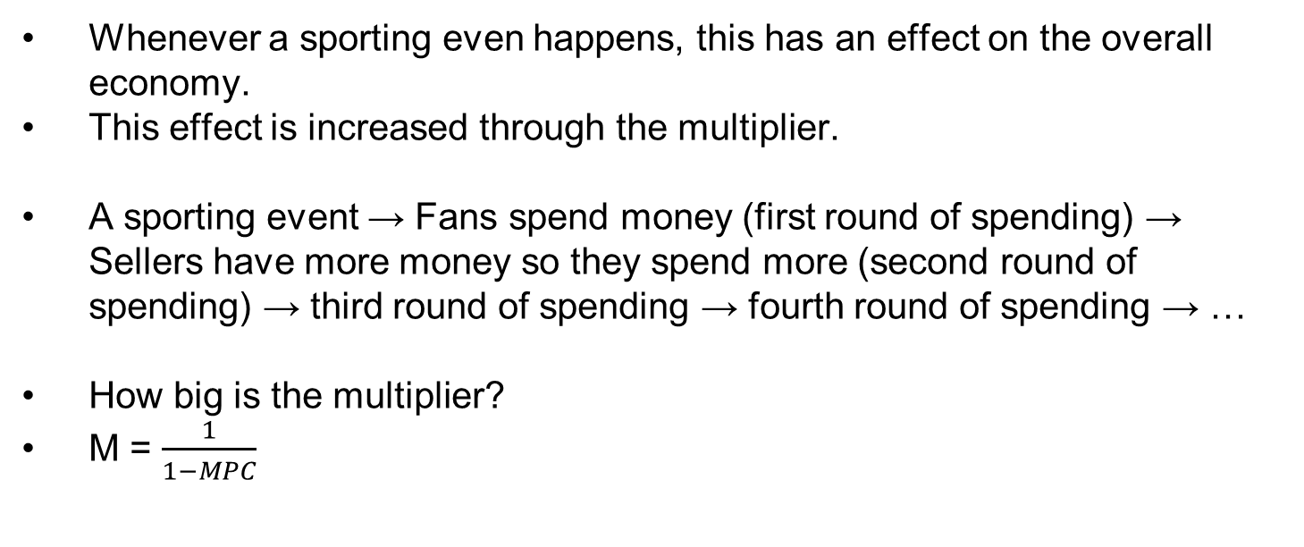
Multipliers
Whenever a sporting even happens, this has an effect on the overall economy.
This effect is increased through the multiplier.
A sporting event → Fans spend money (first round of spending) → Sellers have more money so they spend more (second round of spending) → third round of spending → fourth round of spending → …
How big is the multiplier?
M = $\frac{1}{1−MPC}$

Slide 5
Multipliers
Example: Suppose Pullman population’s marginal propensity to consume is 0.6.
What is the multiplier?
M = 1/(1-0.6) = 2.5
Suppose 20,000 people attend the Cougs’ home game and spend an average of $200 on tickets, food lodging, gas and souvenirs. What is the total (maximum) effect on the economy of Pullman?
First round of spending = 20,000*$200 = $4,000,000
Total Net Spending = 2.5*$4,000,000 = $10,000,000
(the effect of the home game on the local economy)

Slide 6
Multipliers: How to estimate
Analysts start with estimates from a government agency and calibrate them based on the purpose
Sources: regional multipliers from the Bureau of Economic Analysis (BEA). Different multipliers for different expenditure categories: low for expenditures on salaries (because of taxes), higher for food expenditures.

Slide 7
Measuring Incremental Spending
Incremental Spending from a sporting event – spending that happens only as a result of that sporting event. Hard to measure correctly, as one must account for displacement, substitution and attribution.
Displacement
Example: Accounting for fans’ spending at the Superbowl, one must account for whether some Superbowl attendees displaced (crowded out) other visitors in that area.
Displacement can be temporary: Suppose the Superbowl displaced another convention in that area. But perhaps the convention did not move elsewhere and just got postponed by a week – then displacement did not happen.

Slide 8
Measuring Incremental Spending
Substitution
Some spending at a local event is a substitute for other local spending, and should not be included in the economic impact study
Example: A San Francisco resident spent $300 on attending an MLB All-Star Game (ticket, food, drinks, souvenirs and parking). Instead they would have spent the same amount on other local activities: $100 on two dinners, $50 on a round of golf, $25 on a Giants T-shirt, $25 on a concert ticket and $100 elsewhere. Then this is considered substitution.
But maybe the resident would have gone to New York City instead – then this is not substitution since not spent locally. Then this is NOT considered substitution
Attribution
Hard to estimate if the spending happened only due to the sporting event or other reasons
Example: 2006, Orlando, Capital One Bowl (Auburn played Wisconsin). Attendees were local + from out of state (mostly Wisconsin). Most visitors stayed in Orlando for 6 days: some visited Disney World, Universal Studios, Sea World etc.
Did all the visitors come only for the sake of the game? Or did they come because of other attractions in Florida?

Slide 9
Economic Impact of the Super Bowl
According to NFL and economic impact studies commissioned by the NFL: Super Bowl’s economic impact on the host city = $250-$300 mln
Super Bowl attendees spend money at bars, restaurants, hotels, car rental agencies, retail outlets. Most of the spending is subject to sales taxes.
Thus if the NFL’s claims were accurate, we would see a spike in sales tax receipts for January in the county hosting the Super Bowl
Phillip Porter compared sales ax receipts in January for the years preceding, during, and after the Super Bowl.
Finding: No significant effect of the Super Bowl on tax receipts
Super Bowl in Tampa: predicted a net increase of 100,000 people. Porter pointed out that assuming double occupancy, Tampa would need 50,000 hotel rooms to house them, which was over Tampa’s capacity

Slide 10
Economic Impact of the MLB All-Star Game
MLB’s estimates of the economic impact:
Predicted: $62 mln - $75 mln impact from 1999 game in Boston; $70 mln for 2002 game in Milwakee - overinflated estimates for such a short-term event
Why such high estimates?
MLB promises the All-Star Game to host cities if they build new facilities for the home team. Between 1970 and 1997: 15 ballparks built, 13 of them were awarded an All-Star game within 5 years of construction.
Most of the financial support for the construction of the new ballparks come from public funding. MLB’s claims of a $70 mln economic impact of an All-Star game may help convince the public to invest in a stadium
Baade & Matheson analyzed the effect of 23 All-Star Games in 1973-1997.
Finding: No effect in most cases, in one case: decline in employment growth

Slide 11
Economic Impact of College Football
NCAA college football: high attendance, TV ratings, coach salaries, investment in facilities, bow payouts.
This should have a large positive effect on the local economy
Baade, Baumann & Matheson used statistics to estimate the economic impact of college football on the economy of the host city
Examined football programs in 63 Metropolitan Statistical Areas in 1970 – 2004 (every team in Bowl Championship Series conference)
Findings: neither real personal income nor employment received a statistically significant boost from college football games.
Why?
Possible answers: displacement and substitution…

